Slide 1
Welcome!
To the active membership information session about our
23 committees!

Slide 2
Committees in general
Committees organize +/- 150 activities every year
Responsible for every aspect of the activity
Formal, informal, trips, support
Workload per week differs per committee
Practical experience
Co-operate
Meet new people

Slide 3
Different roles
Chairman (letter of motivation)
Treasurer
Marketing Officer
Internal
External

Slide 4
Committees that start in September
Career
Community
Conference
Connect
Formal Master
Informal
Informal Master
Magazine
Member Deal
NCE
Party
Personal Development
PR
Sport
Synergy Drink
Synergy Weekend
Photo

Slide 5
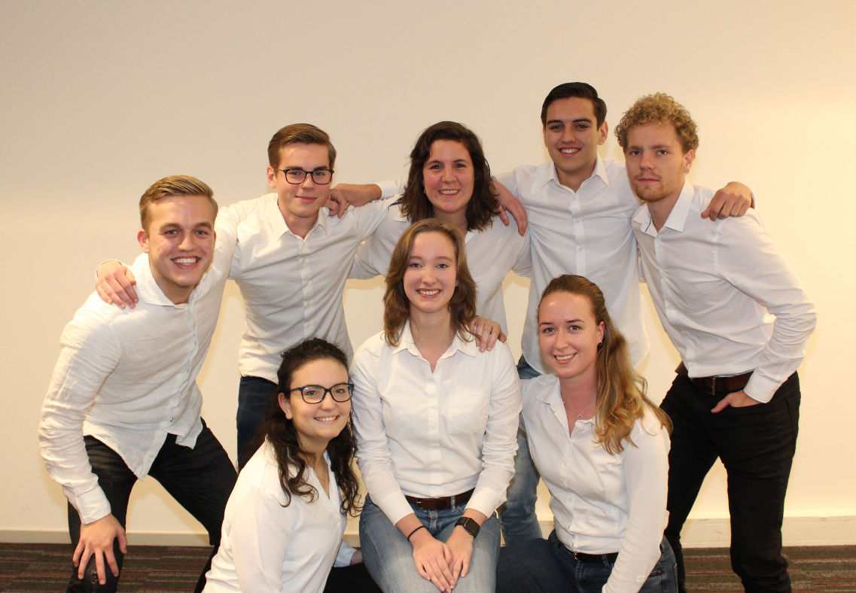
Career Committee
Formal activities
Inhouse days, workshops, readings and a business day
10 committee members
3 hours a week on average

Slide 6
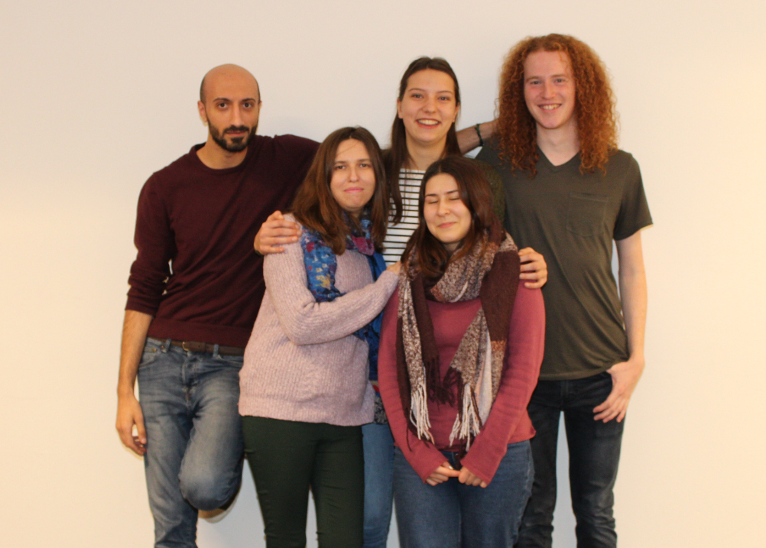
Community Committee
Do something for society
Community day: choose a charity group, fundraising campaign for Serious Request, RAGweek
5 committee members
0-2 hours a week

Slide 7
Conference Committee
Organizing a 1-day conference for fellow students (arrange location, get into contact with several companies, find an interesting speaker, good for your CV, enlarged network)
7 committee members
2-4 hours a week, depending on the time of the year. There is a significant difference between the workload before and after the summer break.

Slide 8
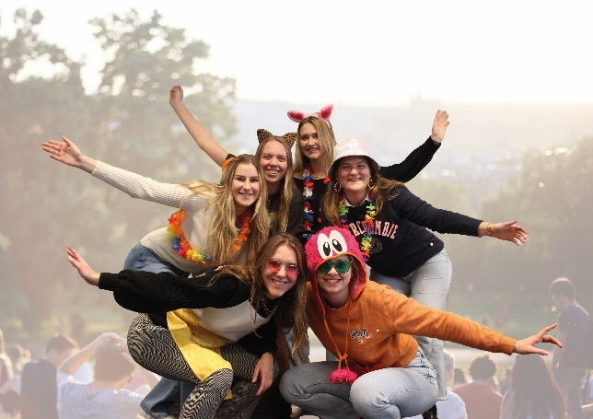
Connect Committee
Activities for specific students per study phase (4x)
Nice committee to start with
10 committee members
1 hour a week

Slide 9
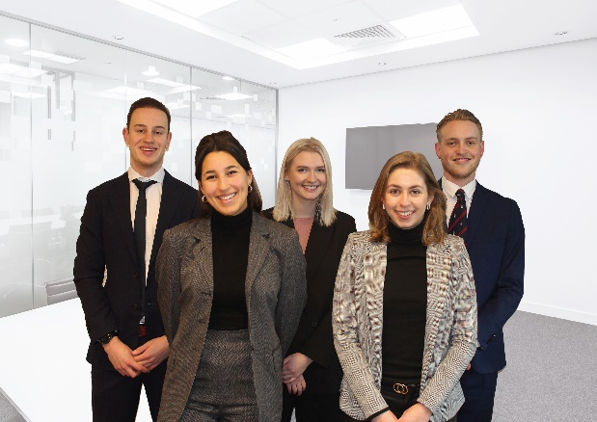
Formal Master Committee
Expand your network by contacting potential future employers
Formal activities (2 recruitment dinners)
7 committee members
2 hours a week

Slide 10
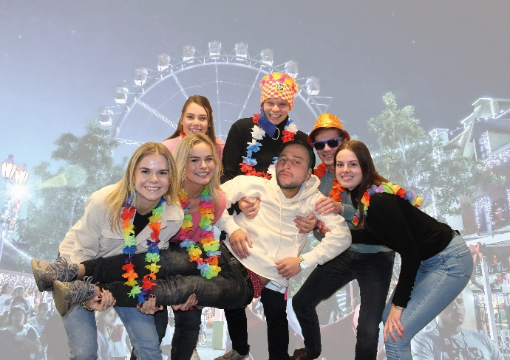
Informal Committee
Informal activities for fun
5 activities
6-8 committee members
1-2 hours a week

Slide 11
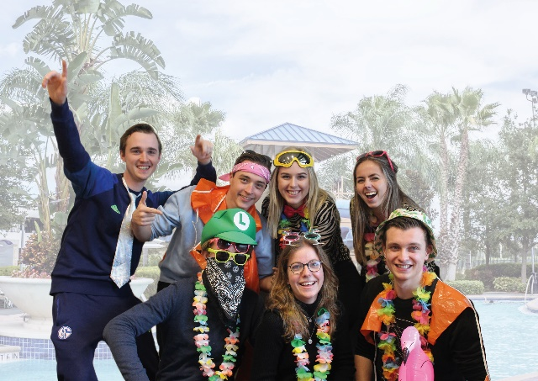
Informal Master Committee
Informal activities for Master students
5 activities
6 committee members
1-2 hours a week

Slide 12
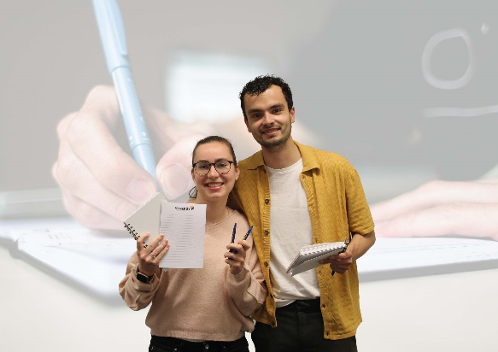
Magazine Committee
Flexibility
Writing for Synergy & companies
Broad topics for a broad study
Write anywhere, anytime
5 committee members
2-3 hours a week

Slide 13
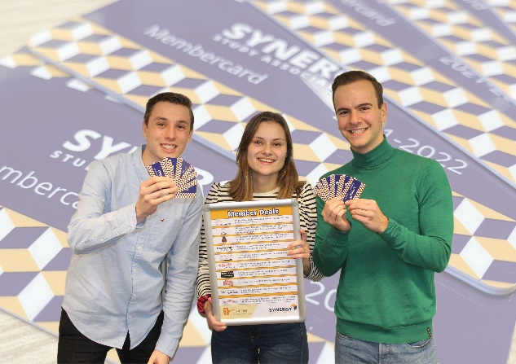
Member Deal Committee
Establish new member deals
Contact companies
Examples of member deals
3-4 committee members
1 hour a week

Slide 14
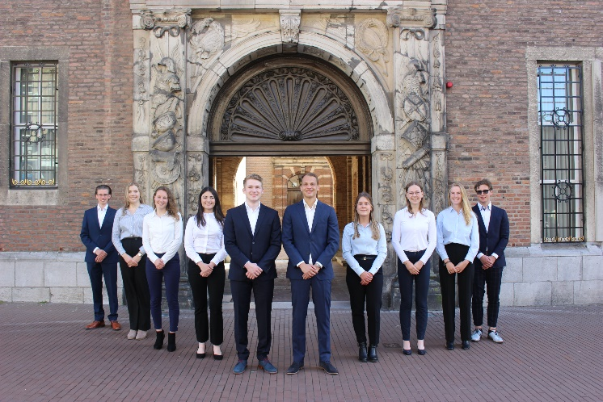
Nijmegen Career Event (NCE) Committee
Organizes the Nijmegen Career Event A two-day event where students and companies can meet each other in both formal- and informal settings
Collaboration between Synergy and ESV
10 committee members
3 – 10 hours per week

Slide 15
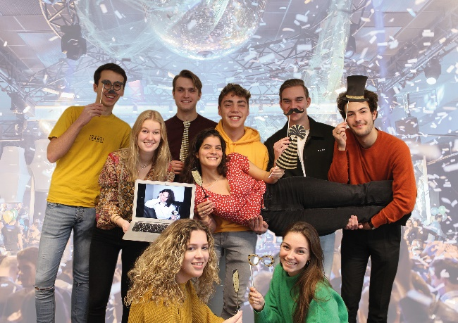
Party Committee
Organises all sorts of parties: - Open BA Party - BeRe Party - Management Madness
Often uses themes
8 committee members
1-2 hours a week

Slide 16
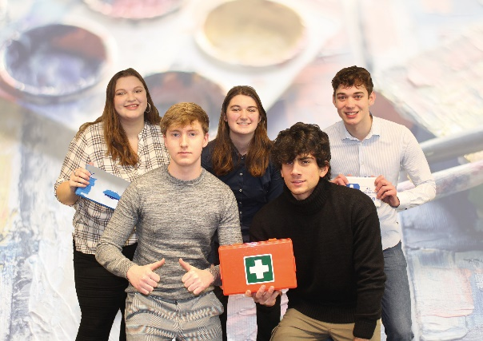
Personal Development Committee
Develop your own practical skills and talent
Not necessarily within a professional context
Focus on finding interesting opportunities for workshops, speakers etc.
4/5 activities
7 committee members
1-2 hours a week

Slide 17
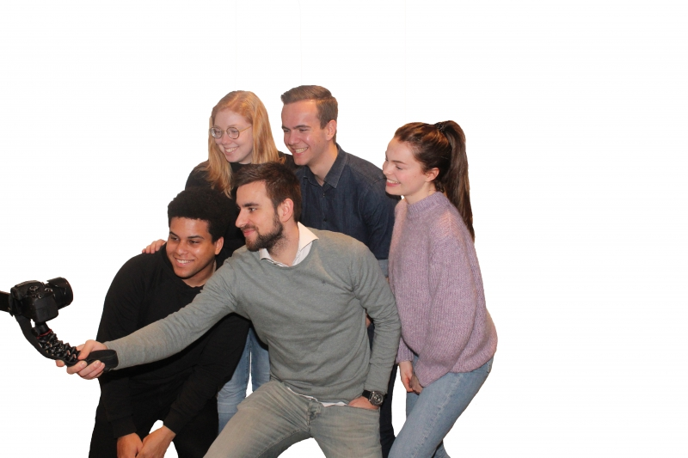
Photo Committee
Making pictures & filming during Synergy activities & making them ‘website ready’
4 committee members (more members possible)
1 to 2 hours a week

Slide 18
PR Committee
Knowledge of Adobe is not necessary, there will be a workshop
Motivated to learn
Video editing
10 committee members
Average time spend depends on the requests

Slide 19
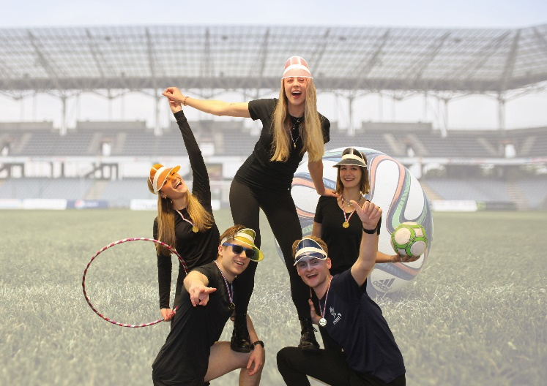
Sports Committee
7 committee members
1-2 hours a week
2 Free activities
2 Fixed activities
Batavierenrace
Soccer Tournament

Slide 20
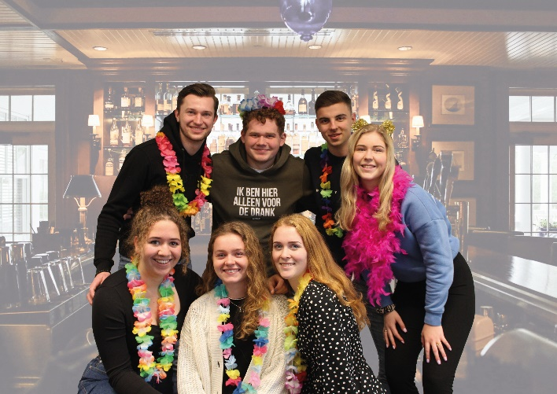
Synergy Drink
What do you organize?
Monthly Synergy Drink
After Exam Lunches/Drinks
Synergy Division
8 committee members
1 or 2 hours a week

Slide 21
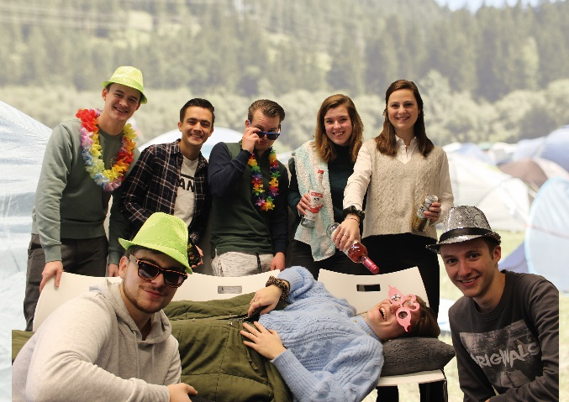
Synergy Weekend
Organising member weekend
The committee organises - Activities - Transportation - Food
7 committee members
1-3 hours a week

Slide 22
Committees that start in February
Atlas Trip
Business Trip
Orientation Week
Kick-off
Ski Trip
Synergy Week

Slide 23
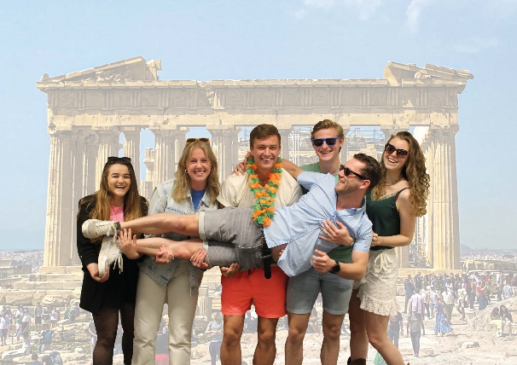
Atlas Trip Committee
Yearly business trip for 40 people, 7/8 days (April/May)
Company visits, cultural activities, clubbing in a foreign city!
6 committee members
1-4 hours a week, differs per period

Slide 24
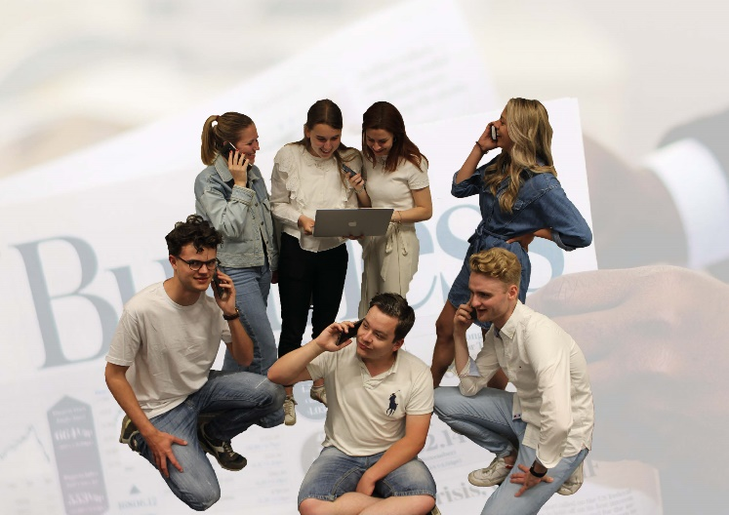
Business Trip Committee
Organising a business trip to an European city
8 committee members
2 hours a week

Slide 25
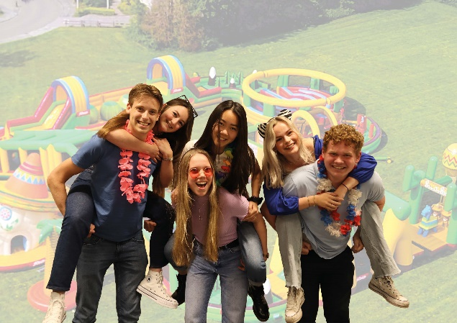
Kick-Off Committee
7 committee members
13 activities (formal and informal) in October and September
2 to 3 hours a week

Slide 26
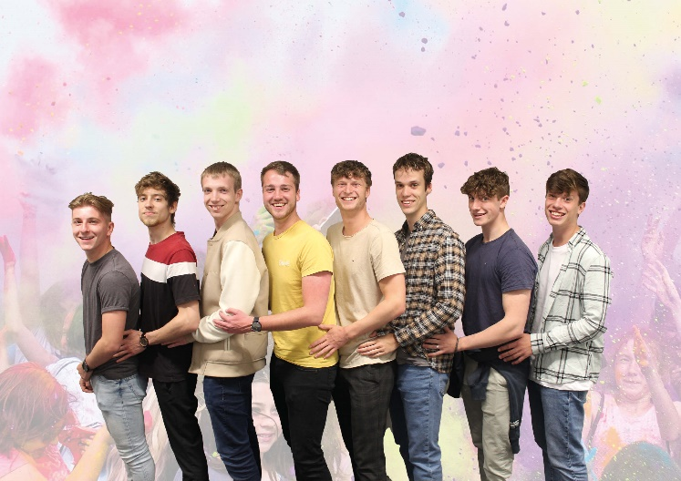
Orientation Week Committee
New students
Orientation week
Orientation battle
Free activity
Three parties
7 committee members
1 hour a week

Slide 27
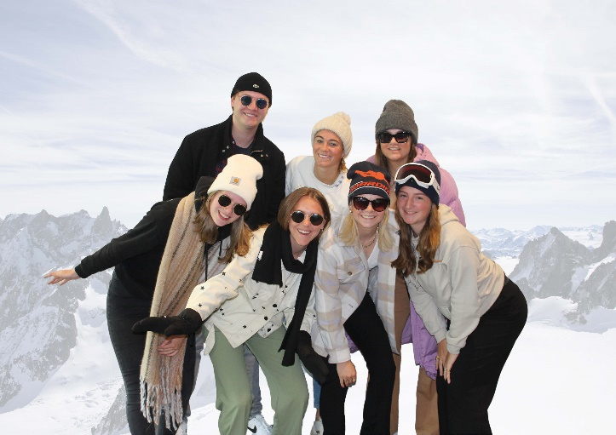
Ski Trip Committee
Organising a ski trip for 40 people
What do you do: - Location - Evening activities - Introduction activity - Final drink
6 committee members
2 hours a week

Slide 28
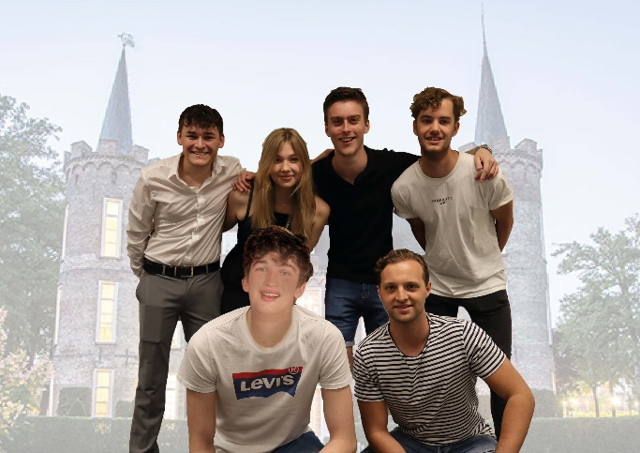
Synergy Week Committee
A week in May full of activities
Formal and Informal activities
Synergy Gala
9 committee members
3 hours a week

Slide 29
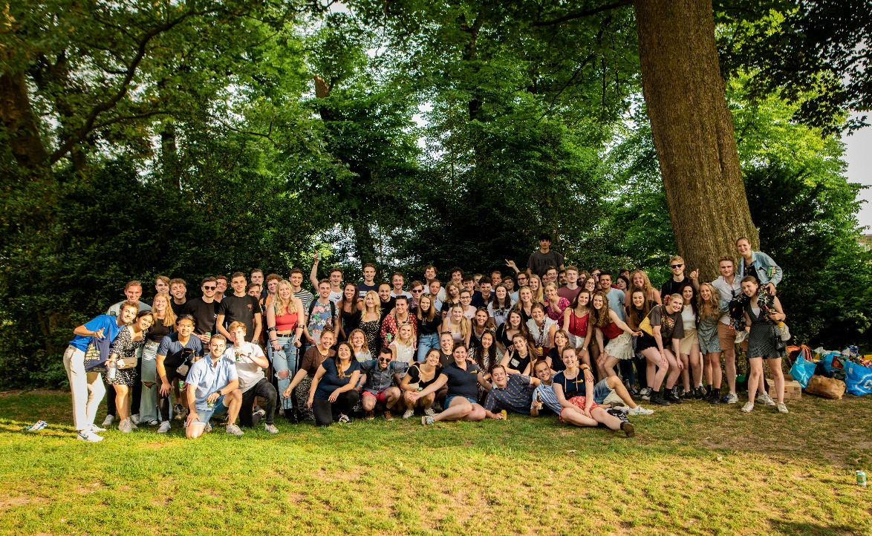
Active Membership Activity

Slide 30
Committee Training
Helps you prepare for your role in the committee
Involves organising, planning, teambuilding and professionalism

